Slide 1
Introduction to Computing in R
SEN1211
Scott Cunningham
30 November 2017

Slide 2
Objectives
Generating, loading and plotting data from NetLogo
Further resources for self-study in R

Slide 3
What You Need
These slides – NetLogoR.ppt
My scripts – scripts.zip
NetLogo.R
Module1.rmd
My data -- data.zip

Slide 4
Why R?
R is the world’s leading language for data science
Highly demanded for research and public sector jobs
R + Python makes an especially winning combination

Slide 5
History of R
A major research laboratory (Bell Labs) made their own computing language for statistics
They called it S
They licensed this language for commercial use, calling it S-Plus
The language died . . .
But some Australians revised it!

Slide 6
What’s R good for?
R is especially known for
Attractive graphics
Effective data management
Trustworthy statistics and machine learning
Useful geo-visualization

Slide 7
Introductions

Slide 8
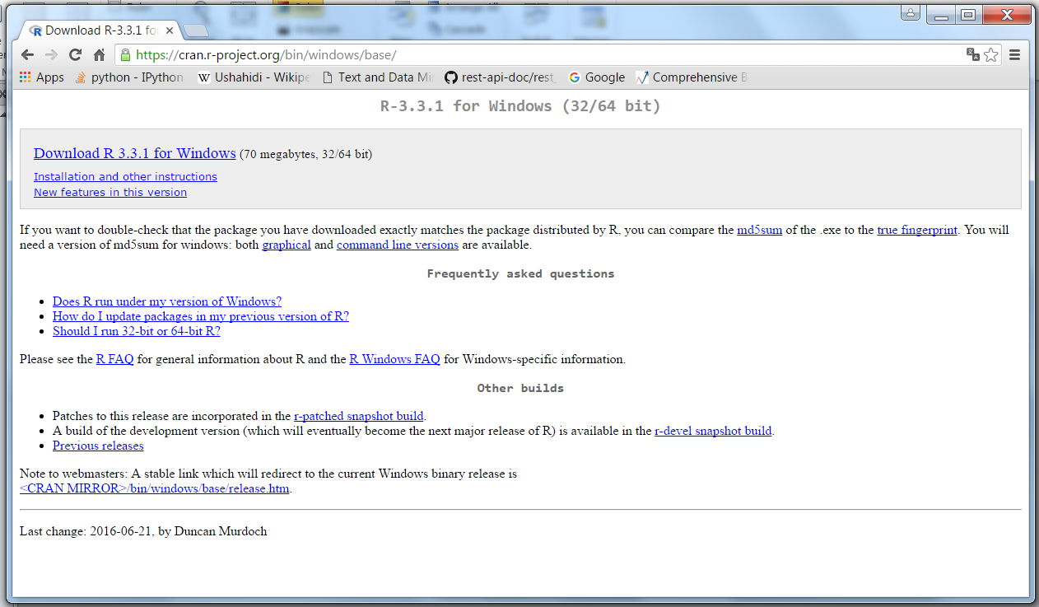
Installation of R

Slide 9
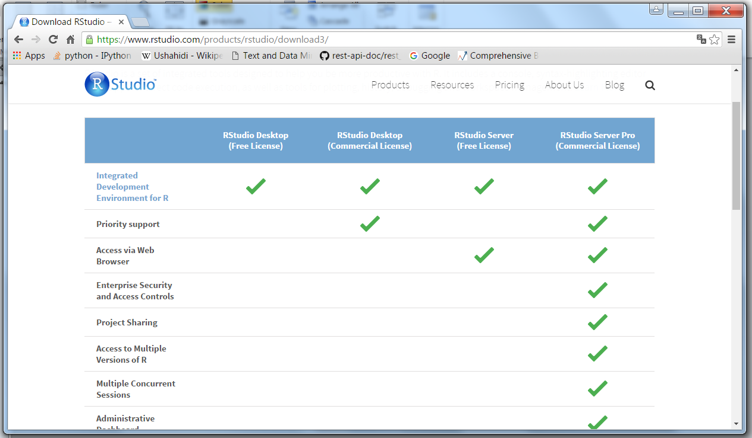
Installation of RStudio

Slide 10

The Anaconda Distribution

Slide 11
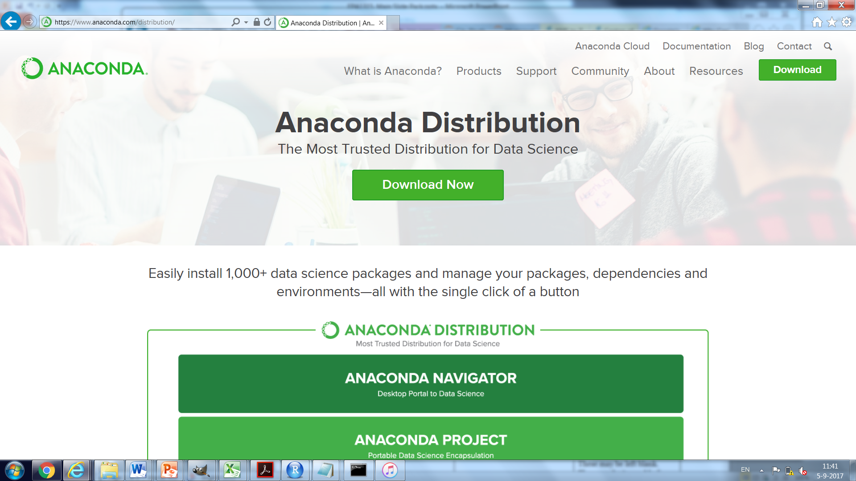
Download R

Slide 12

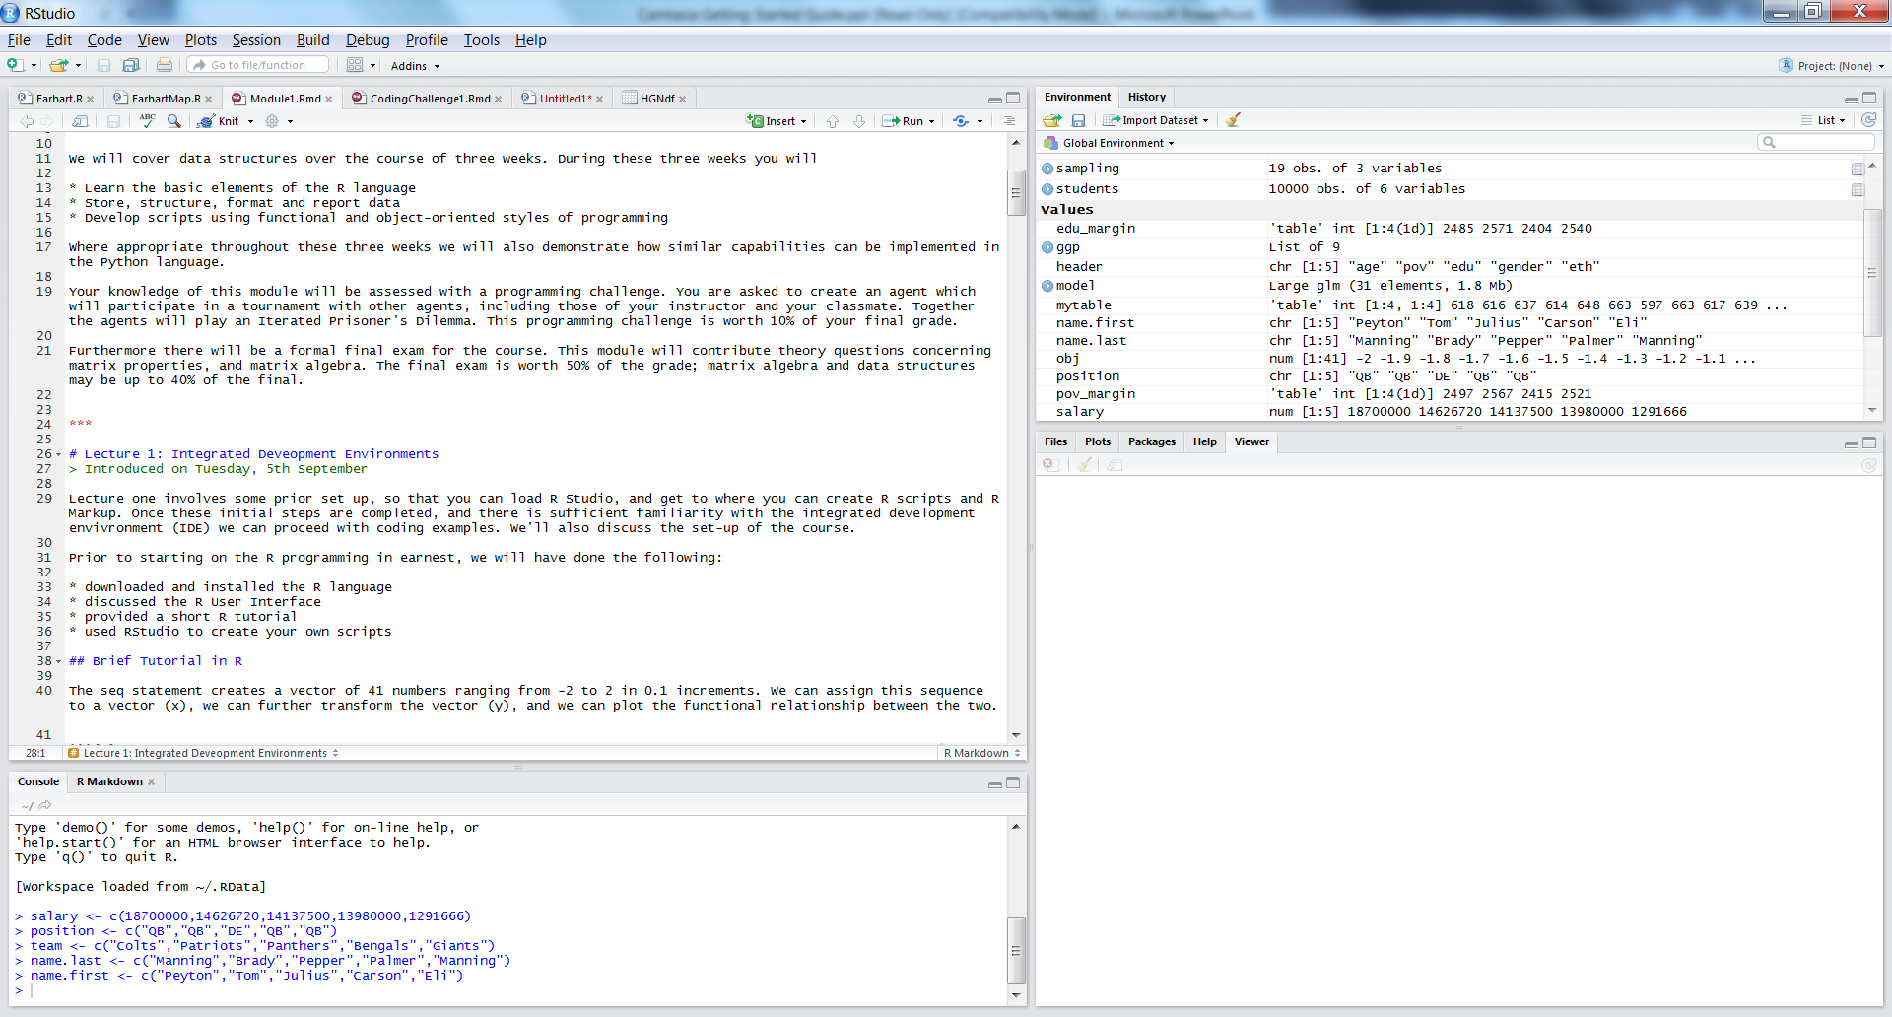
Quick Tour of R Studio

Slide 13
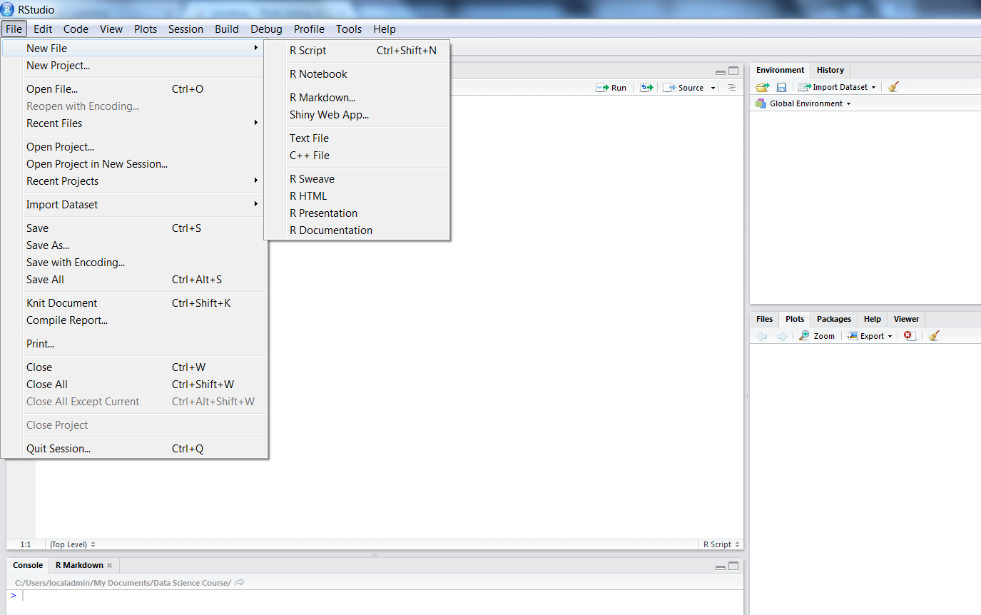
Creating New Files

Slide 14
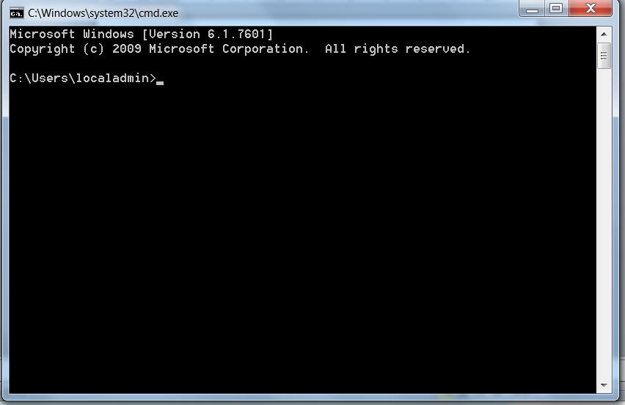
Data Directories

Slide 15
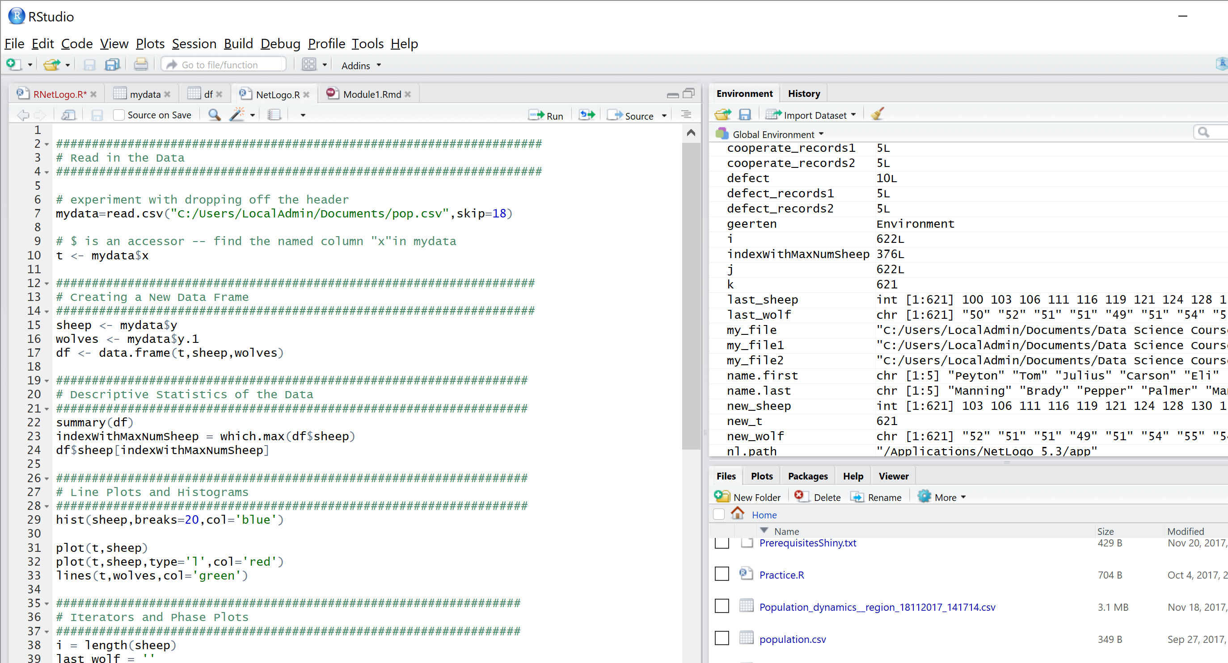
Interactive Walkthrough

Slide 16
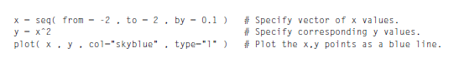
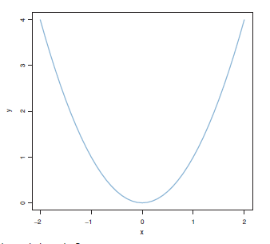
Simple Example of R in Action

Slide 17
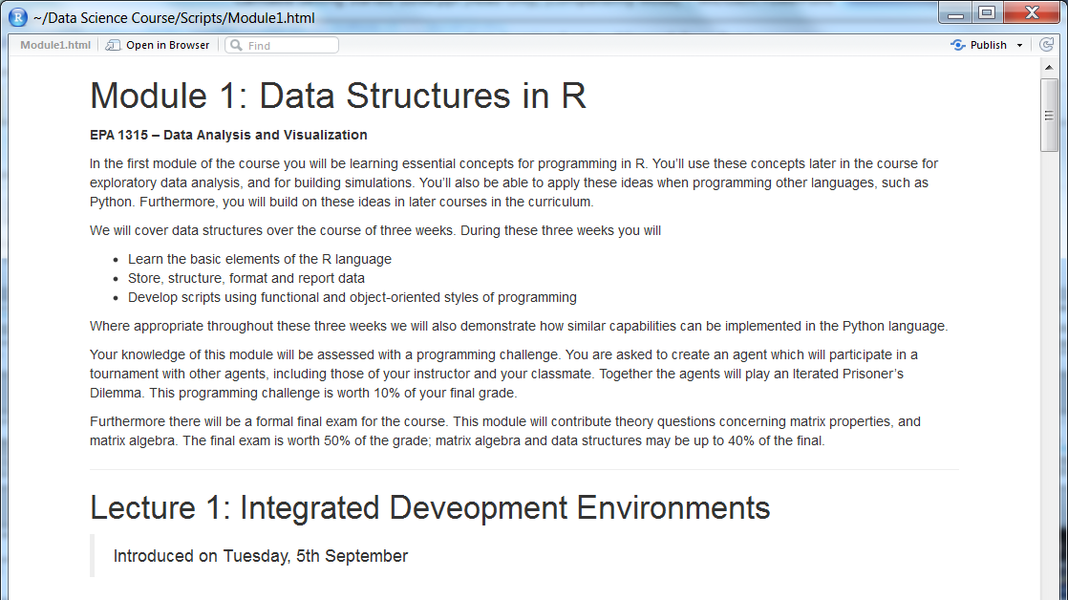
Quick Tour of R Markup

Slide 18
Topics
First Things First
Working Directories
Printing Comments to Screen
Entering Data in R
Editing Your Data in Screen
Saving and Loading R Objects
Exporting Data
Importing Data from Databases

Slide 19
Elements of Learning R
Arithmetic and logical operators
Assignment, relational operators, tests of equality
Functional programming
Conditions and loops
Measuring processing time

Slide 20
Variable Types
Vector. An ordered list of elements of the same type
List. A vector, but with different types
Factor. A vector of categorical values
Matrix. A two-dimensional array of values
Array. A multidimensional matrix
Data Frame. Makes use of multiple lists and factors to support data analysis

Slide 21
Utility Functions
The summary function
The aggregate function
The melt function from the reshape2 package

Slide 22
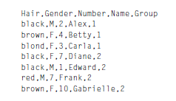
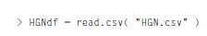
Reading Data
CSV file, a generic text file with entries separated by commas
R command, read.csv

Slide 23
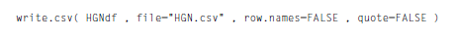
Saving Data
Sometimes we want to save reformatted and transformed data from R

Slide 24
Running a Program
First set the working directory
Many programs read or write data
The default location may have no relevance for your work
So let R know where you are storing your programs and your data
You can then specify other locations with this as a starting point

Slide 25
Debugging
Start with new file names
Name loops descriptively
Explicitly set parentheses
Make good use of whitespace
Use indenting to group sections of the program
(Krushke 2005, p. 67)

Slide 26
Managing Errors
Error messages can be cryptic
Isolate the error at the first point; run sequentially
Check nested functions
Working functions can break; check variables defined outside the function
Make use of advanced facilities such as debug, browser and traceback

Slide 27
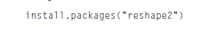
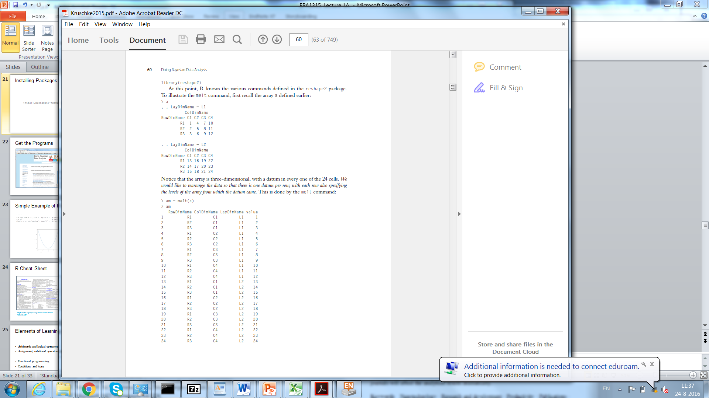
Installing Packages
Installing new packages
Loading existing packages into memory

Slide 28
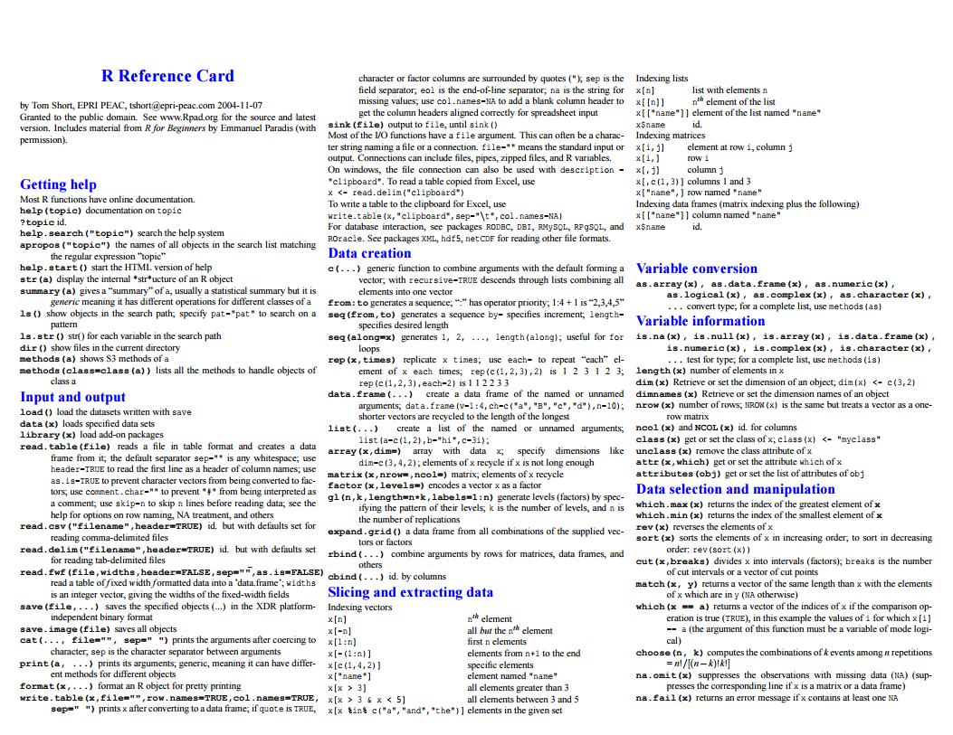
R Cheat Sheet
https://cran.r-project.org/doc/contrib/Short-refcard.pdf

Slide 29
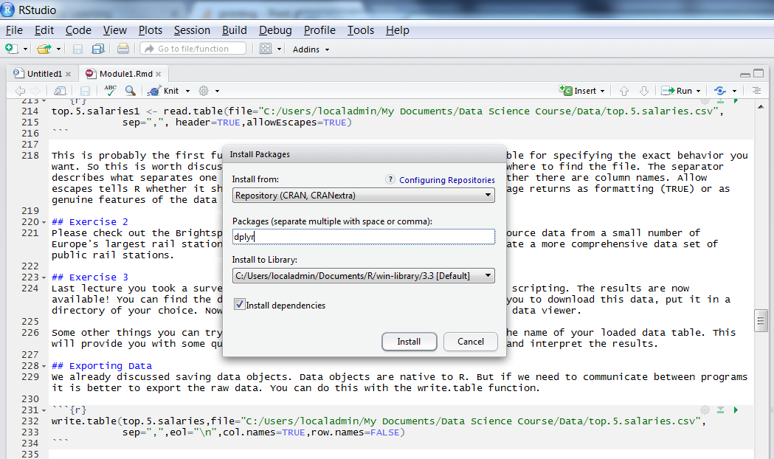
Installing Packages

Slide 30
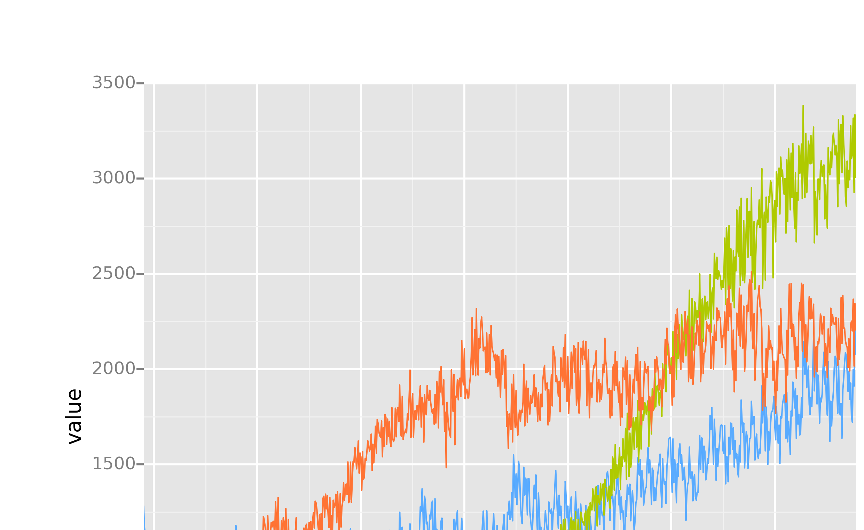
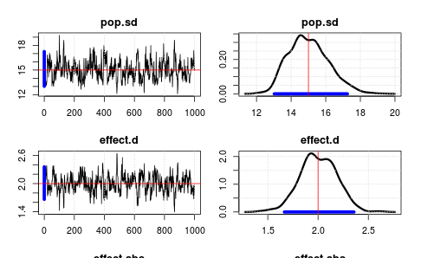
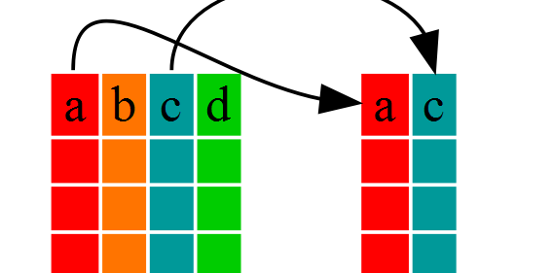

Four Useful Packages in R
GGPLOT
JAGS
DPLYR
R6

Slide 31
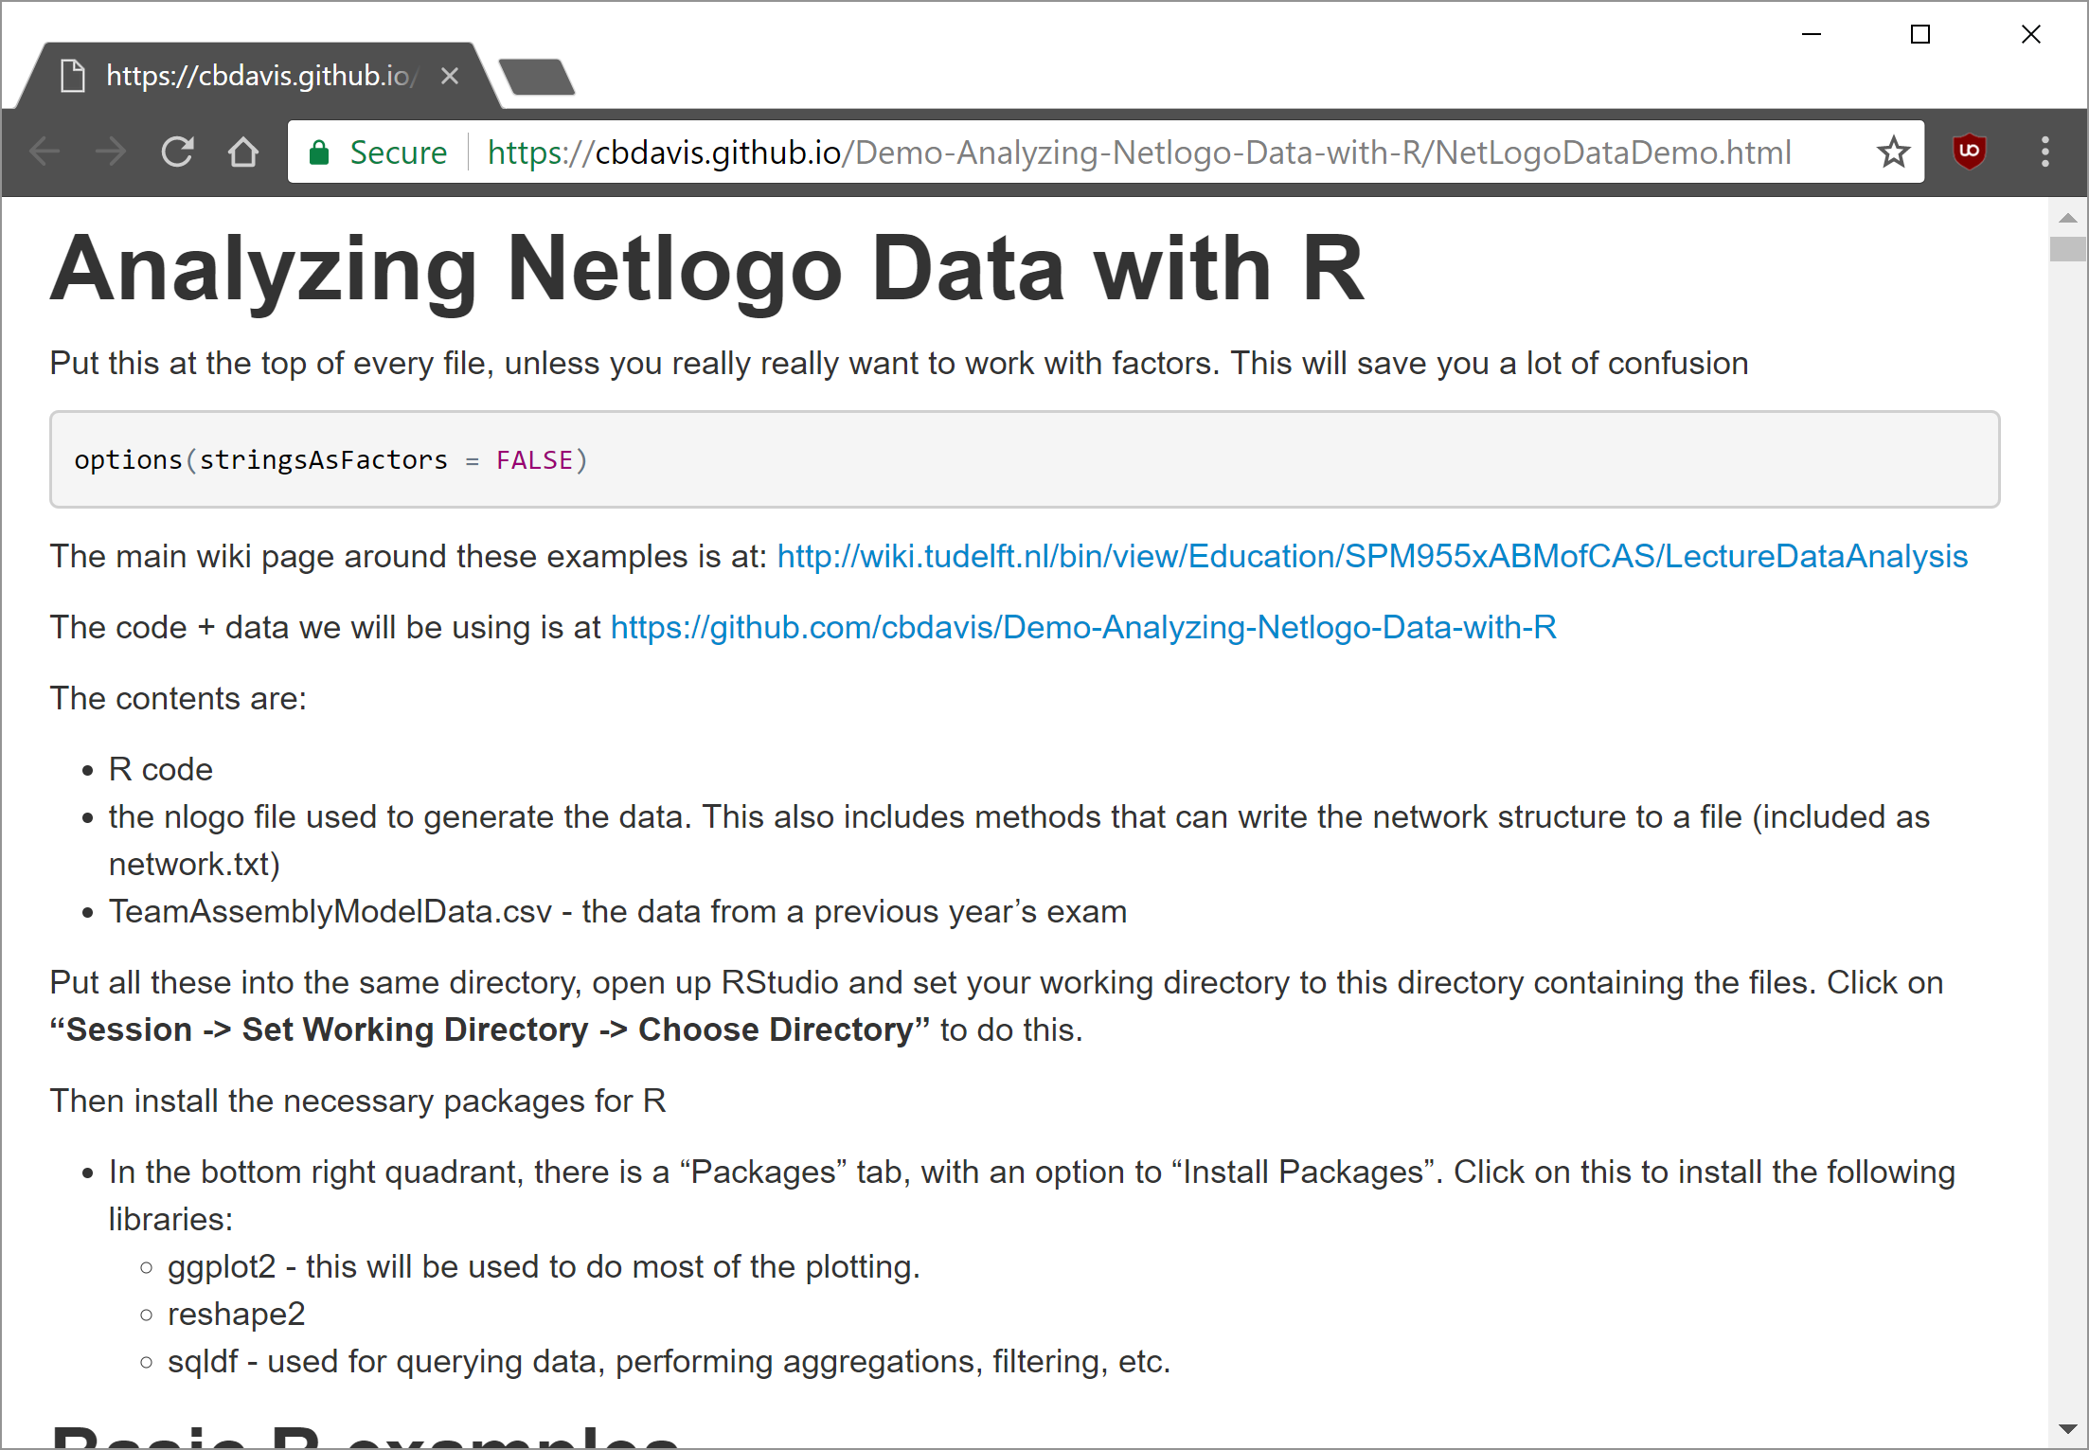
Another Resource!

Slide 32
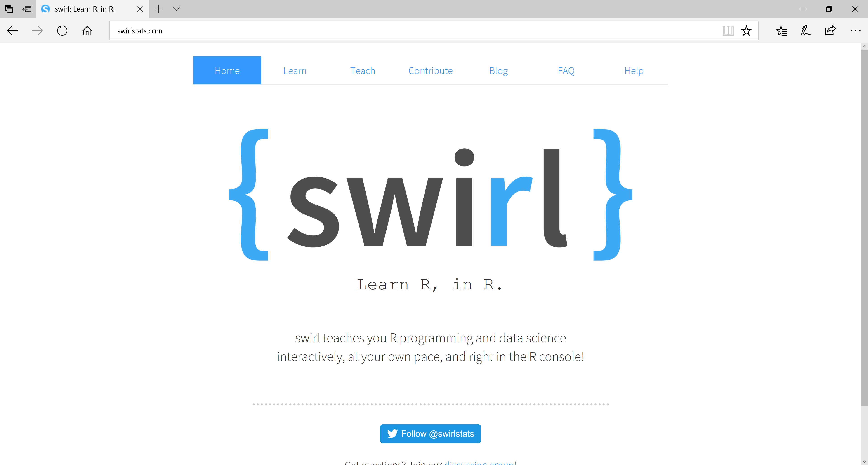
Learn R, in R!

Slide 33
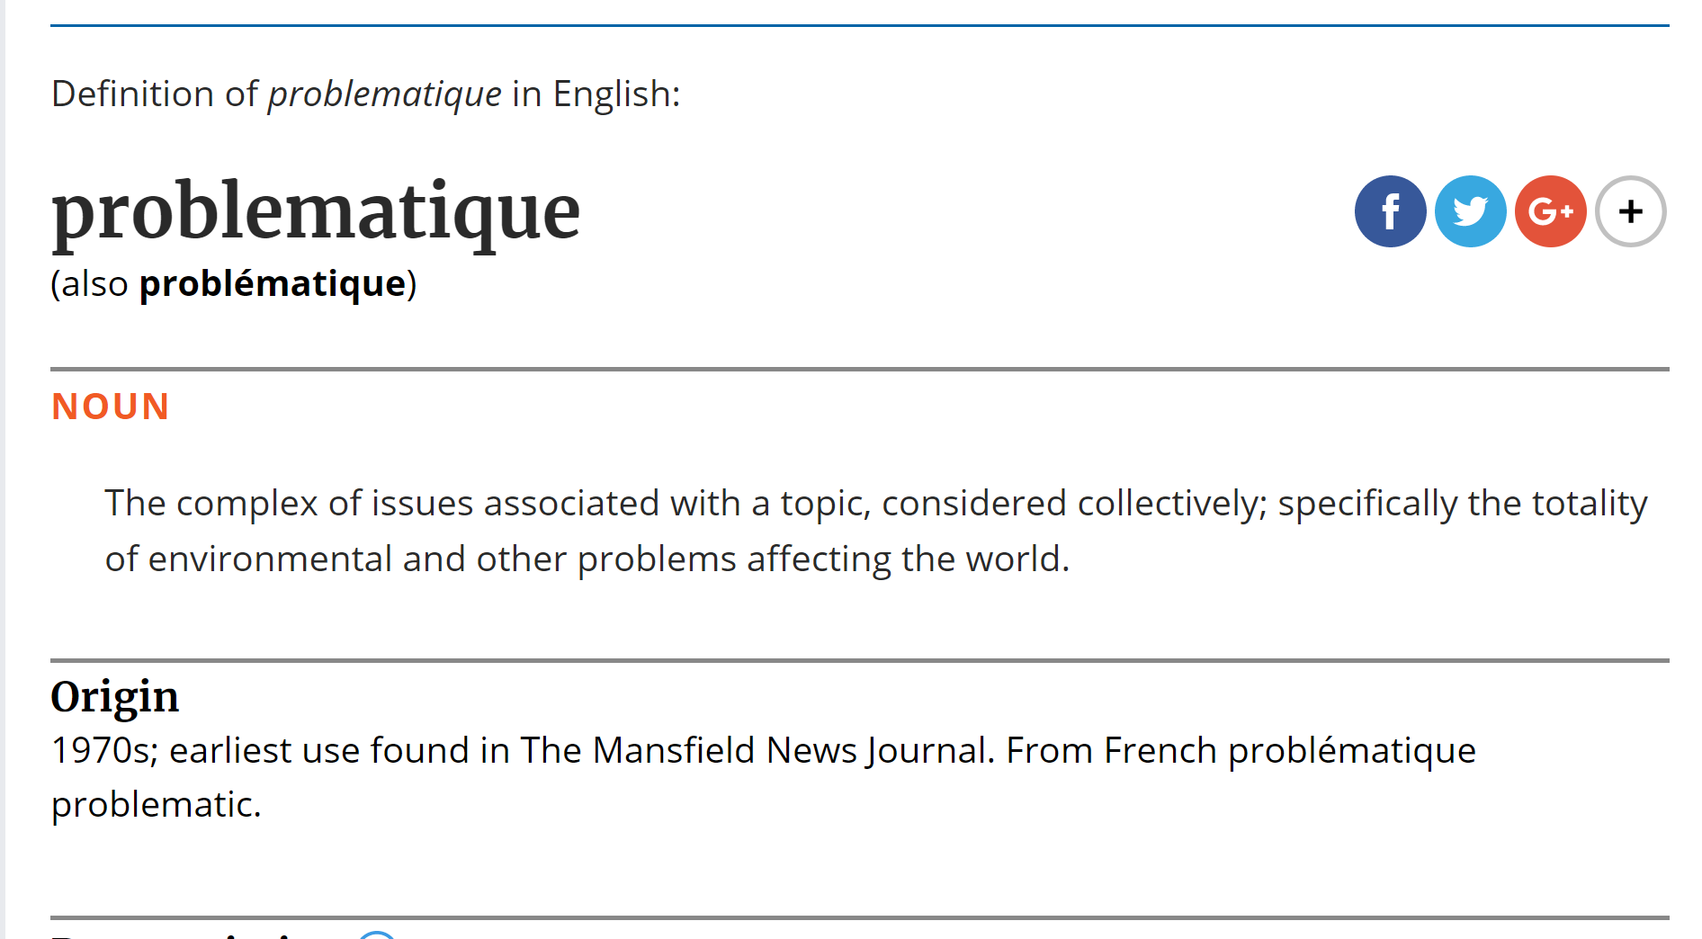

Slide 34
Next Time: Problématiques in Agent-Based Programming
Reporting
Exploratory Analysis
Interpolation
Control
Inference

